Slide 1
Linux – Basic commands
AM Internship, April 2017

Slide 2

agenda
Linux file system
Package managers
Command for learning commands
Moving through file tree
Working with files
Working with file content
Processes in Linux
SSH/SCP
User management

Slide 3
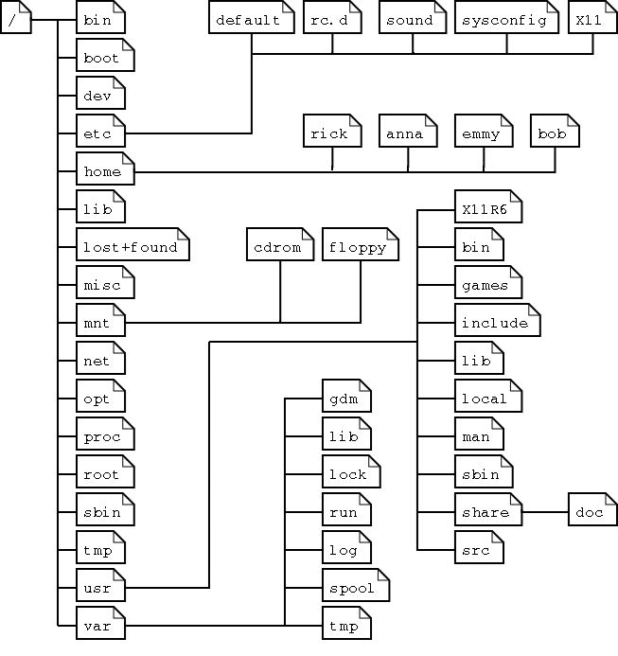
Linux file system
Main folDers
/ - root folder for fs
/bin – common programs
/dev – references to the devices
/etc - configs
/home – users home folders
/lib – external libraries
/mnt – standard mount point
/proc – system resources info
/opt – 3rd party and extra software
/root – home folder for root user
/usr – user`s program
/var – variables and temporary data

Slide 4

Package managers
Package types
rpm– Debian, Mint, Ubuntu
yum - RedHat, Fedora, SUSE
dpkg/deb – APT, Synaptic
Source-based – Slackware, Gentoo
Working with Packages
apt-get update -
apt-get upgrade
apt-get install <app name>
apt-cache search <package name>
apt-cache showpkg <package name>

Slide 5
Command for learning commands
- Man, I don`t know a command <abc>
- Just ask MAN, dude
man == manual pages
man <command> - manual about <command>
man <config.file> - manual about <config.file>
man <daemon> - manual about <daemon>
I don`t wanna read to much
whatis – shows the first line of manual
whereis – the location of manual page
info – just like man but in the info format

Slide 6
Moving through file tree
Lets walk
pwd – Print Working Directory
cd – Change Directory
ls - LiSt
mkdir – MaKe DIRectory
I`m just to tired to type all of these letters
Use Tab key for autocomplete !!!!!
And remember shortcuts!!
. – current directory
.. – a parent directory
~ - home directory
And about absolute and relative paths
/…/…/…. - Absolute path
…/.../... – Relative path.

Slide 7
Working with files
Remember next rules
Case sensitivity !
Everything is a file !
So what can we do with files?!
file – determines the file type
touch – create an empty file
rm – ReMove file
cp – CoPy file
mv – MoVe. Or Rename))
rename – Rename multiple files according to the regexp

Slide 8
Working with file content
OK. So what`s next ?
head – show the first 10 lines of file
tail – show the last 10 lines of file
cat – an universal tool to work with files
tac – an opposite for cat command
more / less– prints file on screen
strings – prints readable strings from (binary) files
nano – simple text editor
emacs – powerful and customizable text editor
vi / vim – most powerful text editor you`ve ever seen ;)

Slide 9
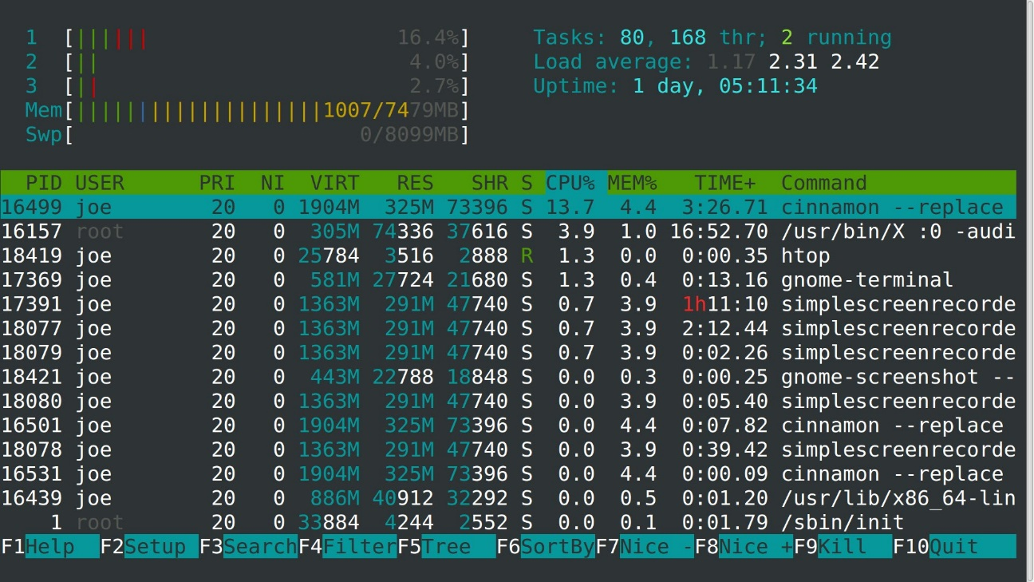
Processes in Linux
What is using my cpu ?!
ps – Process Status
ps -ef / ps aux – see every process
ps axjf – build a process tree
ps o pid,user,command
top/htop/atop – list of all working processes
Well… I need to kill something
kill – kill the process
kill <pid> - try to kill a process
kill -9 <pid> - kill a process with SIGTERM
kill -<signal> <pid>

Slide 10
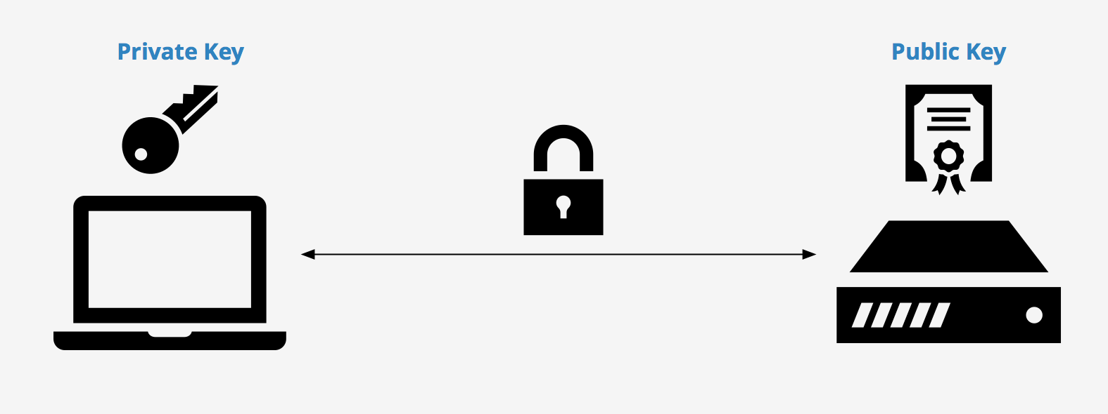
SSH/SCP
What about remotes?
ssh = Secure SHell
ssh-keygen – generate a ssh key
ssh -p <port> <ip>
How can I send files without GUI ?
scp = Secure CoPy
scp <remote_host>:<file> <local destination>
scp <local source> <remote host>:<remote destination>
scp <remote host1>:<remote dest1> <remote host 2>:<remote dest2>

Slide 11
User management
I forgot about myself!!!!
whoami – prints your user name
who – prints all users in system
who am i – prints your username and some additional information
w – print the list of logged users and what they are doing
id – prints your user id, group if, global id and some other
su <another user> - login as another user
Tank you!! How can I find the otters ?
su <another user> - login as another user
useradd <uname> - creates a new user
passwd – change your password
/etc/passwd – info about all users
/etc/shadow – user passwords

Slide 12

Roman Tudvasev
DEVOPS Engeneer

